Slide 1
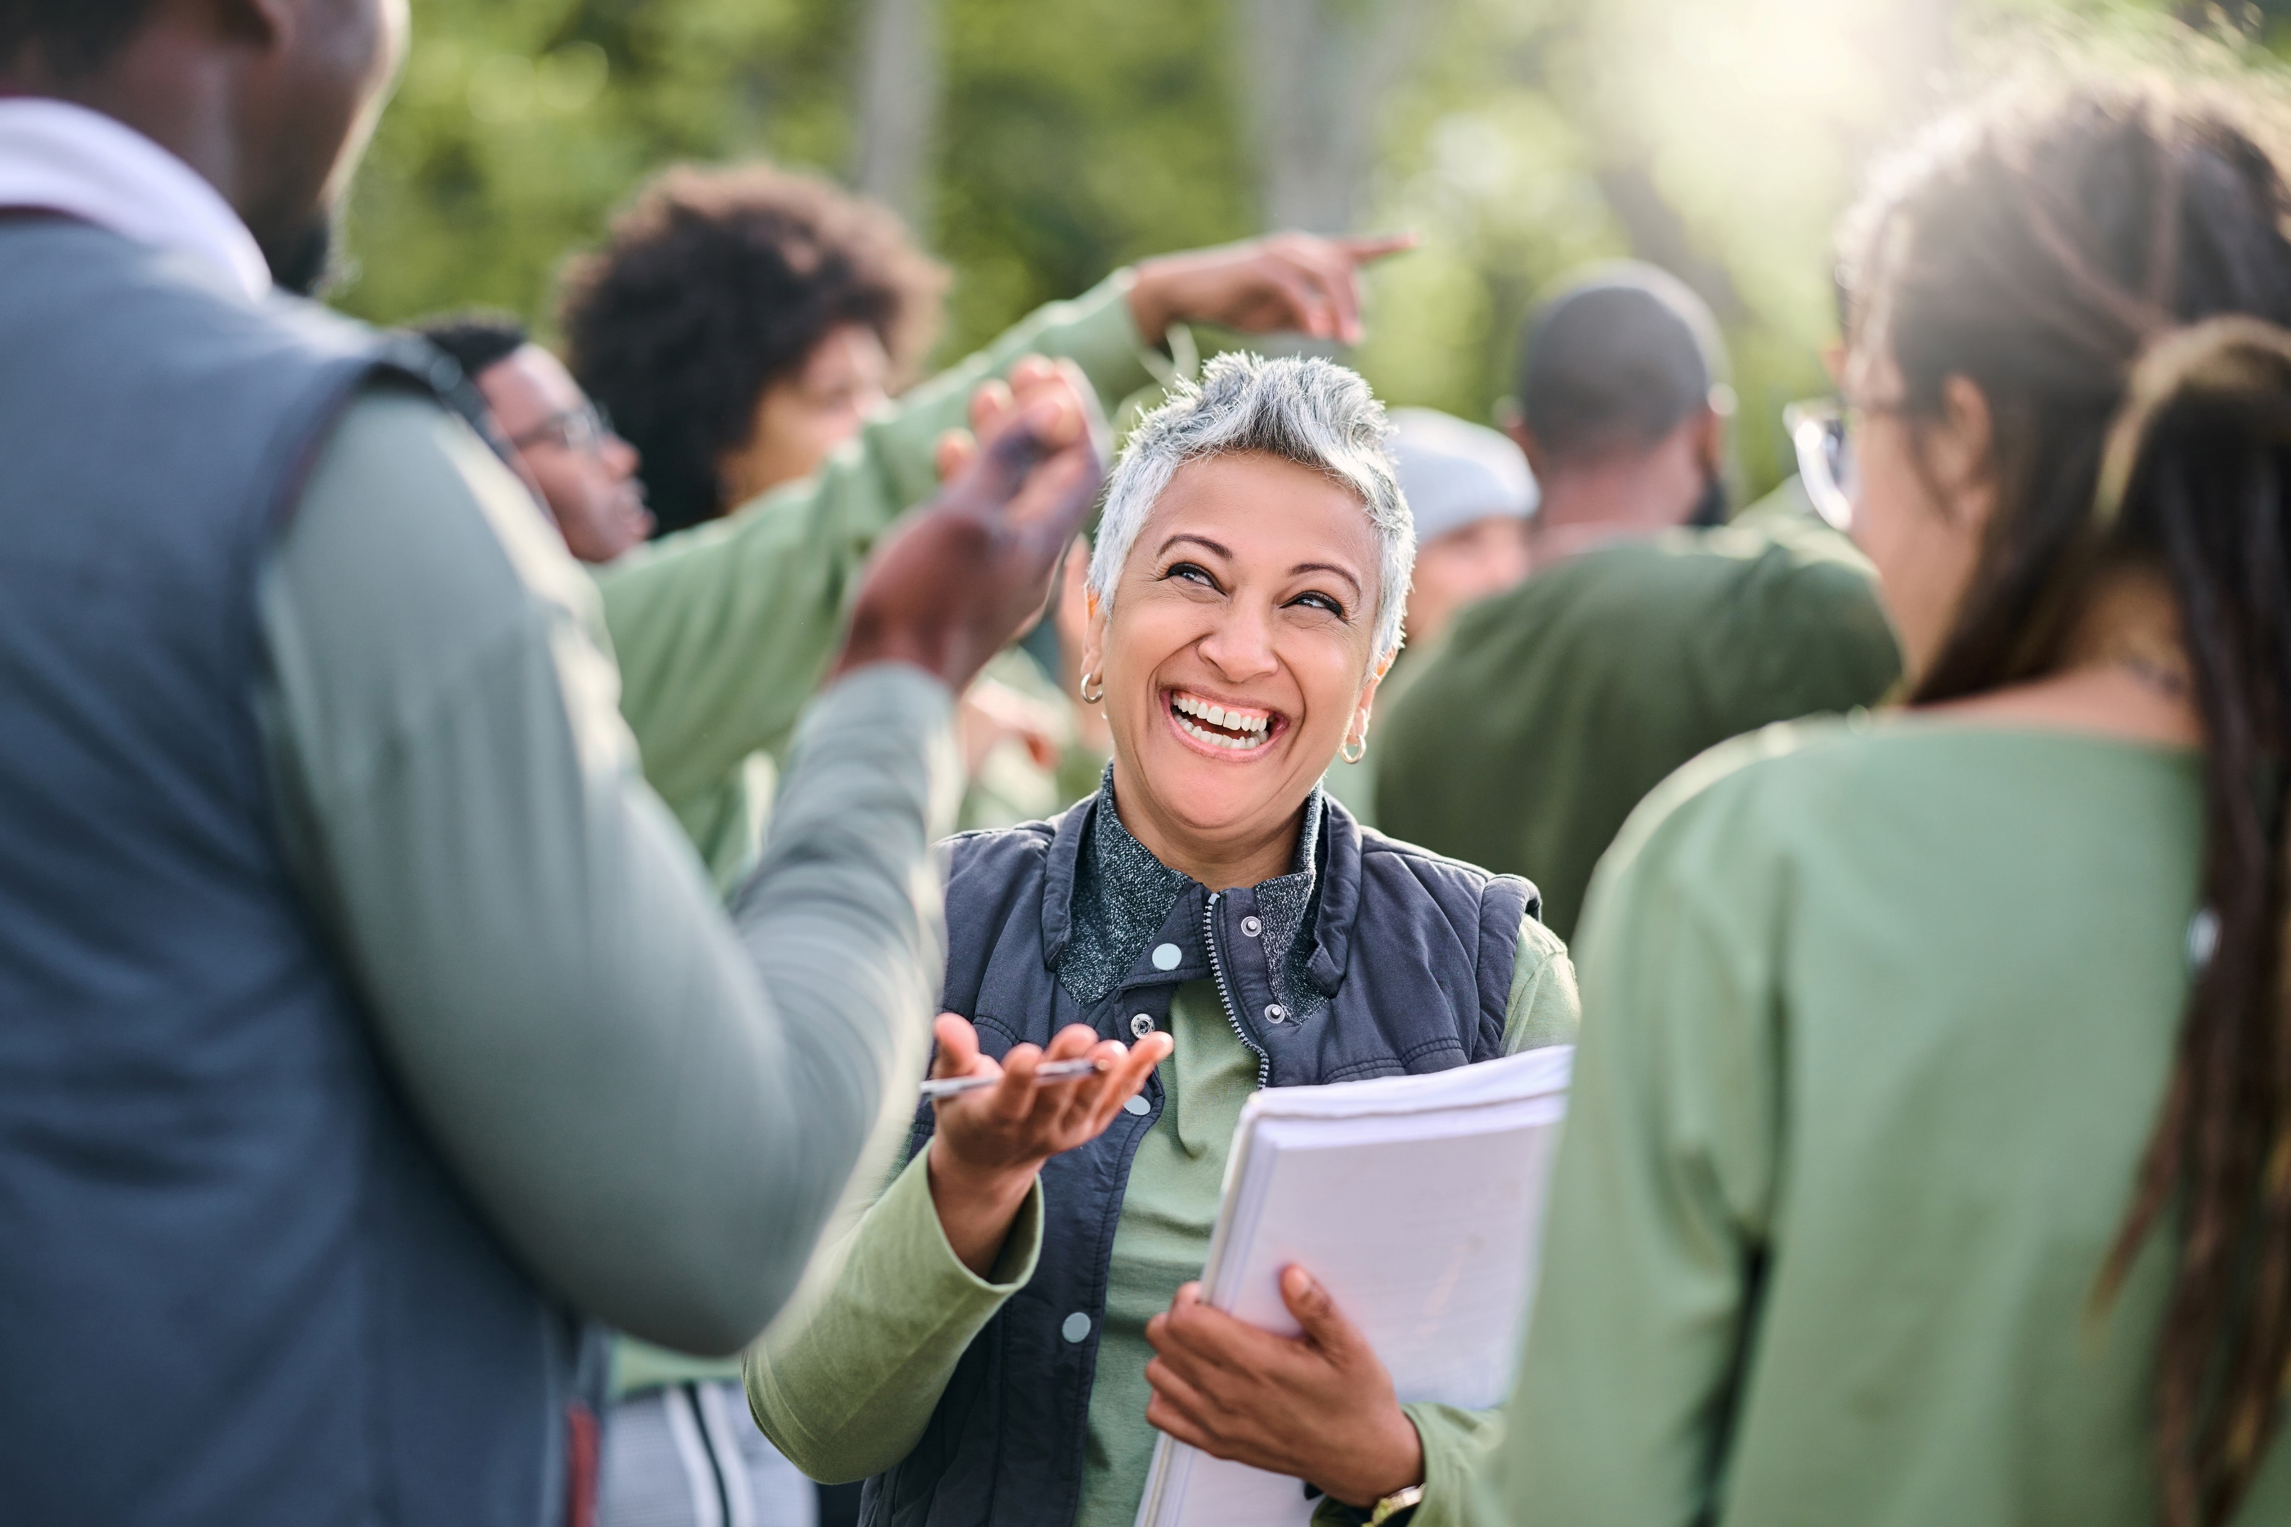
EDUCATORS/TRAINERS GUIDE TO CLIMATE CHAMPIONS Open Education Resources
TRAINERS GUIDE
Notes:
Change to our cover

Slide 2
TABLE OF CONTENTS
01
Welcome
02
About the Curriculum
03
General Instructions for Trainers & Educators
04
Course Delivery Options
05
Course Content Overview
06
Useful Links
07
Sample Timetable
The European Commission support for the production of this publication does not constitute an endorsement of the contents which reflects the views only of the authors, and the Commission cannot be held responsible for any use which may be made of the information contained therein 2021-1-IE01-KA220-ADU-000033706
Notes:
Keep

Slide 3
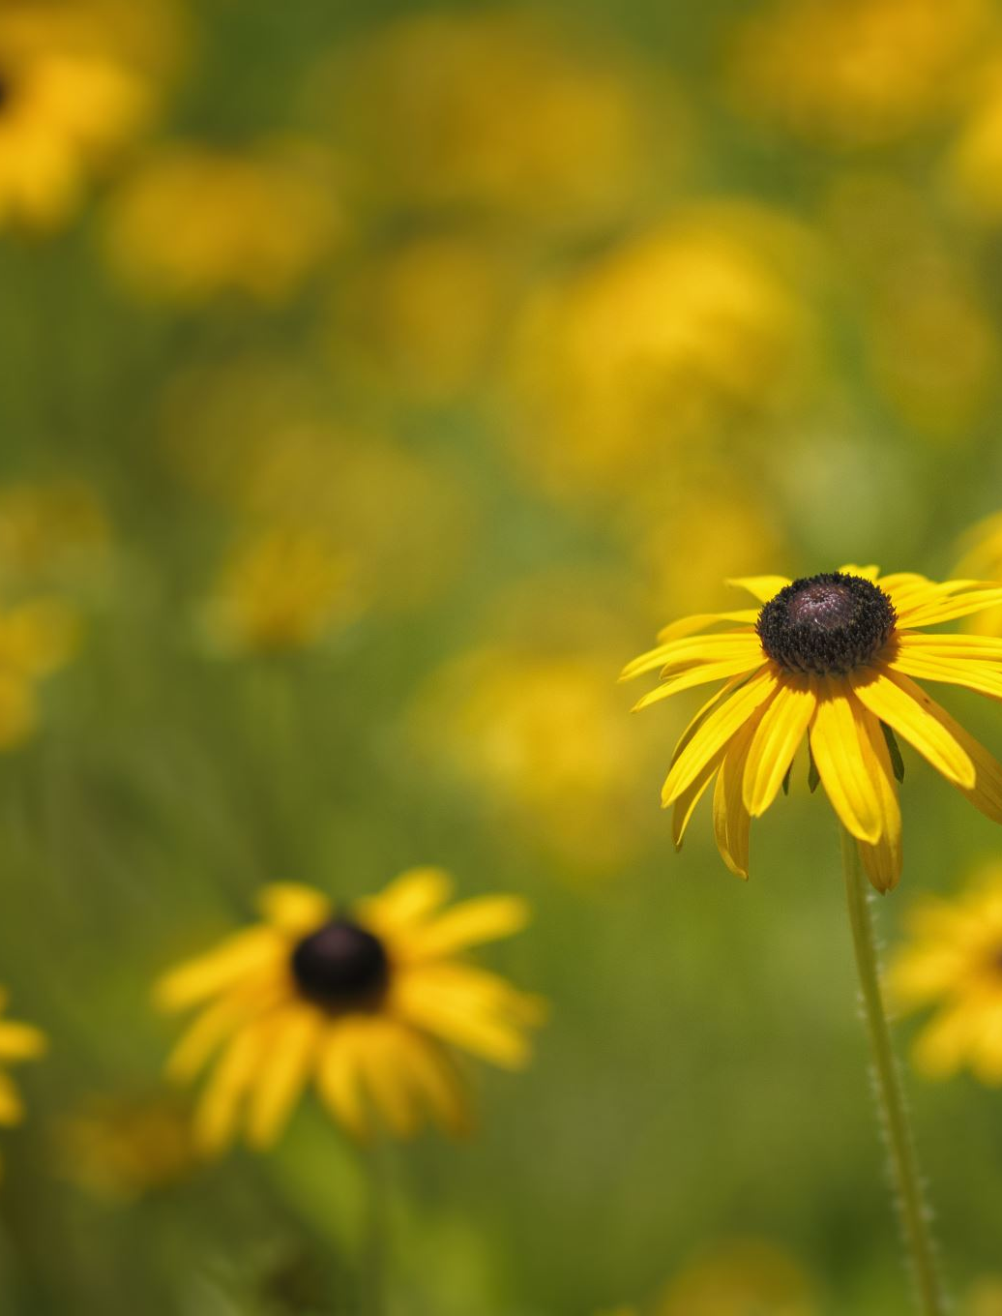
01
WELCOME
Click to type

Slide 4
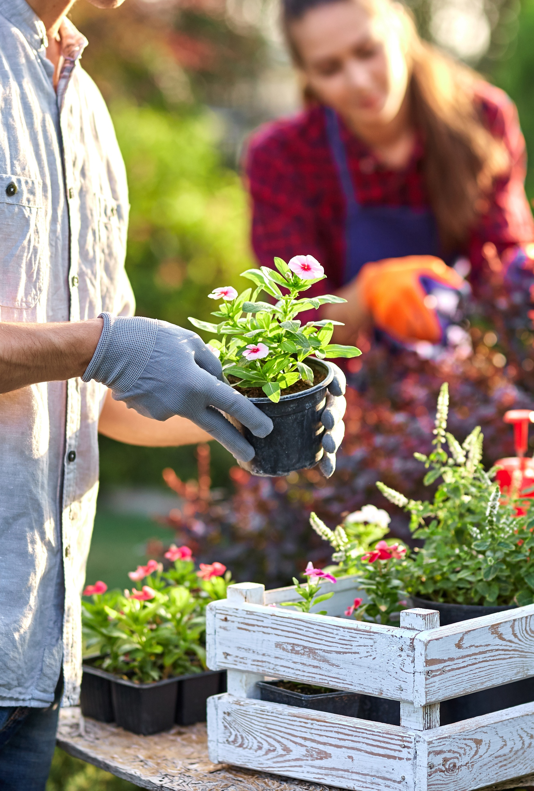
ABOUT OUR PROJECT
The Climate Champions project provides members of the local community the knowledge and confidence to become empowered as community champions, contributing to the 2030 Agenda for Sustainable Development and impacting 6 of the 17 Sustainable Development Goals (SDGs).
The project offers a new field of learning that focuses on social inclusion, our unique approach empowers individuals to become effective advocates for sustainability and uncover innovative solutions to tackle environmental challenges.
Notes:
Keep – will change to about out project

Slide 5
1.0 Preface – What motivate the Climate Champions project and who will benefit?
Our Motivation
Communities everywhere are vulnerable to climate change and reductions in biodiversity.
While youth are growing up in a climate activist world with heightened environmental awareness, adults feel powerless to effect any meaningful change because of the sheer size and scale of the climate change and environmental impact issues and a lack of skills as to where to start.
While climate change education is emerging in formal education, it is hard to find, and access is lacking in the provision of training in local community settings. Biodiversity content is harder to find in formal and informal learning settings. There is no one-size-fits-all solution. Changes must arise from a community-centered process of learning how to live sustainably and regeneratively in a particular locality with its ecological and cultural uniqueness.
The Climate Champions project provides communities with inclusive, driven means by which adults are educated as community champions and by so doing contribute to the 2030 Agenda for Sustainable Development and 6 of it 17 Sustainable Development Goals (SDGs). Climate Champions meets the needs of our partnership in several following ways:
It opens a new field of learning with a very tangible social inclusion intent and reach
Uncovers transferrable learning solutions to empower community biodiversity and climate change champions.
At the same time a new training product will enhance their educational reach & allow them to apply their environmental learning at a strategic level to a community setting. Some partners will be able to expand from their youth and schools’ educational programmes and transfer this knowledge to the adult population.
Who Will Benefit?
Education Bodies
will incorporate Climate Champions resources as part of their adult education offering. They recognise the value of training environmental champions but lack the pedagogical strategies to teach it to others. Our open source resources respond comprehensively in a practical, cost effective manner.
Adult Learners
particularly those not currently involved in the community, to be motivated to increase their civic, personal, and interpersonal, and digital capacity in respect of biodiversity and climate change. They typically live in areas with no access to specialist education provision and form part of a minority community. Climate Champions will address and solve environmental and biodiversity challenges through empowering people at local, micro, community level across Europe through easy to use, education empowerment.
Not For Profit Volunteers From Cause And Community Organisations
will have a channel through which they can become BCC Champions, uniquely positioned in their local communities to promote positive change, galvanize others and create social impact. They will learn from transferrable examples. Social scientists tell us that people are more likely to feel motivated to act when they are not starting from scratch, and when they feel like there is already movement toward a goal.
Biodiversity & Climate Action Advocates, NGOs, networks, regional skills authorities who wish to promote holistic approaches to working with communities, focusing on changing mindsets and promoting local solutions to biodiversity and climate action challenges.

Slide 6






Meet the team – Who is involved?
Roscommon Leader Partnership (RLP) – Ireland are a progressive local and rural development agency of voluntary, community and statutory bodies. They seek to champion needs responsive, local yet outward looking development initiatives which focus on improving the quality of life in Co. Roscommon for all.
Momentum, Ireland is an award-winning Irish educator focused on developing progressive learning programmes (course curriculum and content development) and platforms for education, with a special focus on sustainability, community regeneration, innovation, and marketing.
Anatoliki – Greece is a Local Government Development Organisation in the Region of Central Macedonia committed to the sustainable development of the wider area of Thessaloniki, in the sectors of adult education, environment, energy, human resources and innovation.
Euro Perspectives Foundation – Bulgaria Focuses on unlocking Climate Protection and Energy Efficiency policies at the regional level while also empowering and equipping local communities and voluntary groups to become catalysts for climate action in their own communities. Through their Territorial Cooperation with regional stakeholders in the EU, EPF works towards fostering endogenous capacities and creating a sustainable future.
ADC Moura – Portugal is dedicated to supporting and promoting the sustainable development of the municipality of Moura and other areas within the Alentejo region. With a focus on various priority areas including Training and Qualification, Environmental Education, Community Animation and Citizenship, ADC Moura works towards fostering positive change and growth in the region.
European E-Learning Institute – Denmark is is a leading provider of eLearning and blended learning solutions in Europe.

Slide 7
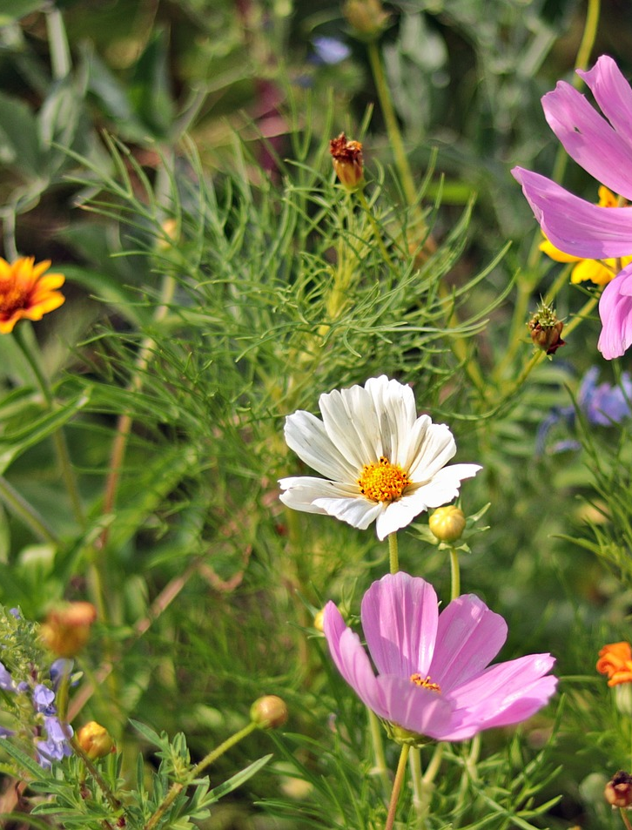
02
ABOUT THE CURRICULUM
Click to type

Slide 8

2.0 About the Project Curriculum and OERs
Climate Champions is an Erasmus+ Strategic Partnership project which focuses on the empowering of Climate Champions in local communities in Europe. It consists of a set of open educational resources created for teachers, trainers, and local communities, published online, and free to download. It promotes the need for change at any level, to try and make a better world and better future.
The Climate Champions Open Education Resources constitute our new training model, designed to educate adults as community champions and by doing so contribute to the 2030 Agenda for Sustainable Development. A new way of learning with a very tangible social inclusion intent and reach.
Climate Champions will contribute to your professional development as Adult Educators/ Trainers, by increasing your pedagogic skills in relation to Climate Change and Climate Champions for local communities.
The OERs, a set of multimedia resources (PowerPoint, documents, worksheets, videos and interactive quizzes etc.), is organised into 6 Modules directly contributing to 6 of the 17 Sustainable Development Goals (SDGs) which are an urgent call for action by all countries.
As educators, we need respond to the needs of communities and adults interested in promoting biodiversity. Across Europe there is a lack of awareness, understanding and practical information available for adult educators and those who wish to be active within the fight against climate change.
Our course responds to these needs though our free, open access materials, created in a user-friendly manner will help you to teach key subjects in a compelling way.

Slide 9

Our ambition for Climate Champions OERs
The course has been developed in two formats:
These OERs and classroom course will allow adult educators to improve their biodiversity & climate action training in communities. We have worked hard to provide educators with high quality materials for both teaching & assessment, to facilitate the integration of the resources into their adult education programmes.
For those unable to attend educators led training, we have developed an online course Online Course EN - Climate Champion (climatechampions.how) to lead learners through the foundations of biodiversity & climate change, and in the way of identifying their strengths & areas of opportunity in their communities.
The Climate Champion partners are very grateful for ERASMUS+ funding to allow us to make an impact. It is important that we share that ambition with you. We are striving for..
Short Term Impact
Provide 300 Educators, VET Trainers and policymakers with rigorously researched, up-to-date knowledge on the Sustainable Development Goals (SDGs) and climate change, giving them the materials for both online and classroom teaching and empowering communities to become Climate Champions.
Long Term Impact
To increase knowledge of Biodiversity and Climate Change, gain an understanding of the implications of climate change at many levels with the focus on communities. Enabling Adult learners, who may not be involved in the community to be motivated and empowered to increase their civic, personal & interpersonal, and digital knowhow in respect of Biodiversity, and to empower learners with skills to become Climate action & Biodiversity changemakers in their own community.

Slide 10
3.0 General Instructions for Trainers & Educators
Methodological Approach
The Open Education Resources consists of a 6 Module Curriculum to introduce learners to the scope and potential of Climate Champions in a way that is both rigorous and congruent with academic research and focused on the real-world use of innovation.
The Curriculum is based on the understanding that there are opportunities present, but that Learners and Educators need assistance in the understanding and urgency of Climate Change, and how to become Climate Champions within their communities.
General Instructions
Please read this guide thoroughly before conducting the training. For classroom, flipped or blended delivery please:
Download, review and revise course resources for the training as necessary. Allow adequate training time for session.
Localise training content with case studies and information on local supports for your students.
Ensure that each participant completes exercises embedded in each Module – these provide valuable learning.
Allow time for review of exercises and provide a feedback loop.

Slide 11

General Instructions for Teachers/Educators
Instructional Approach
The Open Education Resources have been designed to accommodate a range of teaching styles and cultures. As a common thread, each module is presented in the following design.
The topic is introduced briefly before delving into the subject matter.
Information on the Sustainable Development Goal covered, with challenges and opportunities presented. Moving onto more general definitions to more detailed applications, enabling the scope of the topic to be understood.
Knowledge is reinforced, and skills are developed as students/learners participate in practical exercises or study questions.
4.0 Course Delivery Options
Classroom Training & Tools required
Classroom training remains one of the most popular training techniques for building skills capacity. Typically, it is instructor-centred face-to-face training that takes place in a fixed time and place. We would really encourage that this training is rooted din community-based learning. Impact can be achieved by communities joining together to progress this training – it can augment environmental improvement actions. For such training, we provide …
Classroom Tool | Suggested Use in the Classroom | Additional Resources Required
PowerPoint © presentation | Training materials are developed in PowerPoint. We provide 6 ‘ready-made’ PowerPoint decks that you can adapt to your priorities and circumstances. We suggest that these will be displayed on a large screen for classroom delivery | Laptop/ Computer Projector Large screen / wall
Videos | Videos are used to explain certain sections of the training content and to present case studies for discussion. | Audio / sound system
Whiteboard or Flip Chart | Invite learners to write on the board or ask them for feedback that you write on the board | Pens / markers

Slide 12
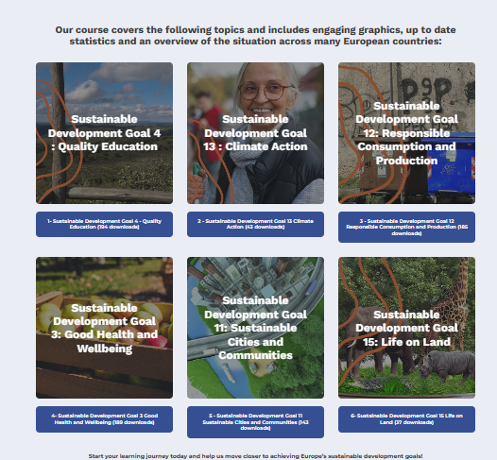
Course Delivery (continued)
Suggested delivery mechanisms:
Small group discussions: Break the participants down into small groups and give them case studies or work situations to discuss or solve. This allows for knowledge transfer between learners.
Q & A Sessions: Informal question-and-answer sessions are most effective in small groups and for updating skills rather that teaching new skills. These should be used frequently across course delivery.
Multimedia: Multimedia training materials tends to be more proactive and challenging and therefore, more stimulating to the adult mind. Trainers should ensure that all imbedded tools are used to their full potential.
Interactive Tools: The engagement of learners can be easily achieved by using interactive tools. An example of a free tool is Kahoot! Which is a game-based learning and trivia platform used in classrooms, offices, and social settings. You can compline a quiz, which can be answered by the students on their phones/tablets/computers. It is possible to get immediate feedback and results.
Other teaching methodologies:
Flipped Classroom - In a flipped classroom learners study the module content prior to the class with a focus on exercises and assignments in class. The classroom transfer of knowledge make way for online instruction outside the classroom. This creates more room for practicing in class, for extra explanation when needed, and offers the possibility to dive deeper into the materials during class time.
Blended Learning - Combines online digital media with traditional classroom methods. It requires the physical presence of both teacher and learner, with some element of learner control over time, place, path, or pace. Learners attend a classroom setting with a trainer present, face-to-face classroom practices combined with computer-mediated activities regarding content and delivery.
Collaborative/Peer-to-Peer Learning – Is an educational approach to teaching and learning that involves groups of learners working together. An example for boosting collaborative and peer-to-peer learning is Peer review: Peers in the classroom are brought together to jointly evaluate the work by one or more people of similar competence to the producers of the work. Peers not only assess the performance of each other but also share their experiences and know-how.
If classroom-based training is not possible in your circumstances, we encourage you to direct learners to our Online Learning This delivery method uses online technologies embedded in the Climate Champions learning platform to deliver a broad array of solutions to enable learning. The Climate Champions course is provided as an online learning platform, for direct access by all stakeholders including, trainers, students, NGOs, Sustainability SMEs and employees, on the topic of Climate Change and Biodiversity. The project platform is a multilingual, interactive site combing informative resources with vital information on Climate Change, Biodiversity all aligning with the Sustainable Development Goals. The online learning facility incorporates best practice in online learning so that while the learning objective remains the same, the user interface and experience can be different as befits the medium.
Online Course EN - Climate Champion (climatechampions.how).

Slide 13
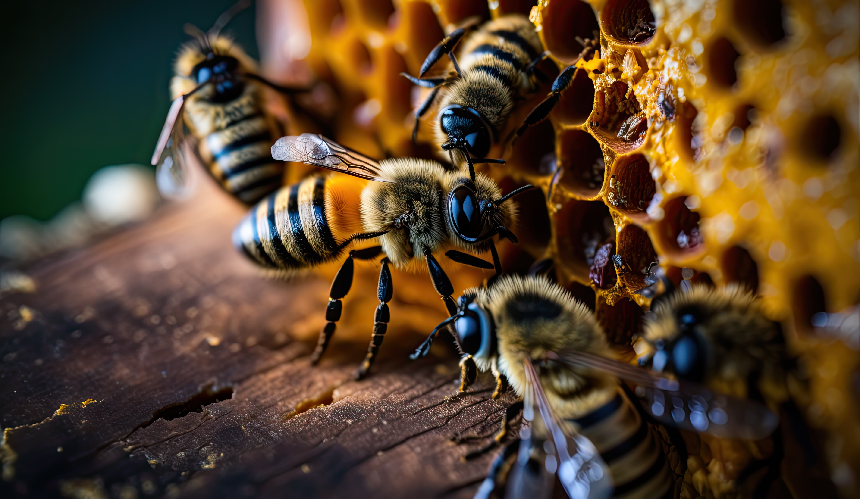
What the Modules cover
The Open Educational Resources consists of 6 Modules to introduce learners to the scope and potential of Climate Champions.
Module 1 SDG4 – Quality Education
This module serves as an introduction to set the scene as to why we need greater education in the area of Biodiversity and Climate Change. We put in context what are the UN 2030 Agenda and the Sustainable Development Goals (SDGs), and explore what is Education for Sustainable Development (ESD)? Importantly, learners will be motivated about how can we involve the community in action for sustainable development.
Module 2 SDG13 – Climate Action
This modules provides a real understanding of what is Climate Change, what is causing it, what are the impacts of Climate Change and very importantly, what can we do about it.
Module 3 SDG12 – Responsible Consumption and Production
This module explores the dangers of overproduction of waste and overconsumption of energy, water and food. We learn about the circular economy and share some good practices on responsible production and consumption.
Module 4 SDG3 – Good Health and Wellbeing
Climate change and health are inextricably linked. This module sets out how healthy living and promoting well-being at all ages is essential to sustainable development. Importantly, it focused on good health and wellbeing at community level.
Module 5 SDG11 – Sustainable Cities and Communities
Biodiversity & Climate Action have a huge role to play in Sustainable Cities & Communities. This module explores how we can make cities and communities inclusive, safe, resilient and sustainable.
Module 6 SDG15 – Life on Land
This module is dedicated to Biodiversity. We bring learners through what is Biodiversity, and what does it do for us. What are the threats to biodiversity and most importantly, what can we do for Biodiversity?

Slide 14
5.0 Course Content Overview
MODULE 1 | Quality Education (SDG 4)
Overview | This module is an introduction to the Climate Change Community Champions Course and is specially dedicated to Education and Sustainable Development Goal 4 – Ensure inclusive and equitable quality education and promote lifelong learning opportunities for all.
Learning Objectives | To equipe Adult Learners with the basics of climate change and biodiversity to empower them to become Climate Champions in their communities.
Topics Covered | What are the UN 2030 Agenda and the Sustainable Development Goals (SDGs) What is Education for Sustainable Development (ESD) How can we involve the community in action for sustainable development
Table of contents | A call to action for Climate Champions SDG4 & Education for Sustainable Development Learn & Act now in your community Toolbox: Organising a community project at school Summary & Review
Case studies | Slide 5 -Making change happen in your community – Josefa is if the power force within AMUPAL. Slide 7 – Mobilising for preservation of natural values.
Questions | Can you think of examples of change making projects? What are the 2030 Agenda and the Sustainable Development Goals? What is the main objective of SDG4 – Quality Education and what matters are most relevant in Education for Sustainable Development policies? Point out some key roles of educators and communities and key competencies for sustainable development. What relevant topics should we have in mind when starting a community project?

Slide 15
Course Content Overview
MODULE 2 | Climate Change and Community Action (SDG 13)
Overview | This module is an introduction to Climate Action and is purposely focused at beginners' level.
Learning Objectives | To equip Adult Learners with information about what is Climate Change, what is causing it, what are the impacts and what we can do to help prevent it.
Topics Covered | What is Climate Change? What is causing Climate Change? What are the impacts of Climate Change? And what can we do?
Table of contents | A call to Climate Action Climate Change: What’s causing it? Climate Change: The Impacts Actions: Individuals and Communities Summary
Case studies | Slide 16 – Carbon Sink Spotlight: Raised Bogs (Ireland)
Questions | How has your perception of Climate Change evolved throughout this module? What are some initial thought in how you can contribute to Climate Action? Can you remember the differences between Global Warming and Climate Change? Can you remember the main Greenhouse Gases? How does the impact of human activities on greenhouse gas emissions make you reflect on the need for sustainable practices? What Carbon Sinks have you identified in your community? How can we protect and restore these natural carbon sinks to help combat climate change? How can collective action across these sectors lead to meaningful change? What small steps are you going to take to create a more sustainable future in your community? What role do you envision yourself in contributing to climate action and fostering a sustainable future?

Slide 16
Course Content Overview
MODULE 3 | Responsible Consumption and Production (SDG 12)
Overview | This module is an introduction to being more responsible with consumption and production of energy, water and food.
Learning Objectives | To equip Adult Learners to be able to develop and implement tools to monitor sustainable development impacts for sustainable tourism that creates jobs and promotes local culture and products.
Table of contents | Overproduction of solid waste and overconsumption of energy, water and food. What to do? The Good news The Good Practices Summary
Case studies | Slide 40 – The Island of Lipsi (Aegean Sea) promotes Sustainable tourism. Slide 41 – Community Compost, Spain Slide 42 – Elementary pupils recycle batteries, Greece Slide 43 – French Supermarket food waste ban Slide 44 – Central Market of Thessaloniki Greece Social Responsibility Practice

Slide 17
Course Content Overview
MODULE 4 | Good Health and Wellbeing (SDG 3)
Overview | This module is specially dedicated to SDG3 – Health and Wellbeing
Learning Objectives | To equip Adult Learners with information about the need for Good Health and Wellbeing at all ages as an essential part to a sustainable future.
Topics Covered | SDG3: Good Health and Wellbeing Ensuring healthy lives and promoting wellbeing at all ages is essential to sustainable development Let’s focus on SDG3 at a community level
Table of contents | Let’s reflect on our health and wellbeing right now. Climate Change and Health Climate Change and Wellbeing Mobilise your community to contribute to SDG3 Summary and Review
Case studies | Slide 21 – Community Garden in Ireland – We’re looking for you Slide 23 – Mud Island Community Garden, Ireland Slide 26 – Biodiversity in Dublin City, Ireland Slide 33 – Back to Nature: Forest bathing blossoming in Co Wicklow, Ireland Slide 41 – Clean Air Together

Slide 18
Course Content Overview
MODULE 5 | Sustainable Cities & Communities (SDG 11)
Overview | This module is specially dedicated to SDG11 Sustainable Cities and Climate Action
Learning Objectives | To equipe Adult Learners with information on how to make their communities feel inclusive, safe, resilient and sustainable
Topics Covered | SDG11: Sustainable Cities & Communities – The importance of Biodiversity and Climate Action The Mission of SDG11 is to make cities and human settlements inclusive, safe, resilient and sustainable.
Table of contents | A call to action on SDG 11 – Sustainable cities and communities SDG 11 Key element, challenges and opportunities Things we can do as individuals, as communities. Policy tools for urban sustainable development Summary
Case studies | Slide 32 – Resource Efficiency Repair and Re-use – SUEZ Recycling, recovery and waste management, Manchester, UK Slide 34 – Reuse – Book Saviours Slide 35 – CashON – Bring back a box – save a tree Slide 38 – Blagichika – Zero Waste – Bulgaria Slide 39 – Food Waste Prevention – Cozzo App, Bulgaria Slide 40 – Foodhub- Digital Distribution Centre for Local Food Slide 44 – Renewable energy charging station for electric vehicles – Alterna Coop Valencia, Spain Slide 47 – Oldham Community Power Slide 49 – Clothing as a service model – Vaatepuu Finland Slide 51 – Electric Vehicle Car sharing platform – Zoom EV Slide 60 – Green City Tool – Leuven 2030 City Roadmap

Slide 19
Course Content Overview
MODULE 6 | Life on Land (SDG 15)
Overview | This module is an introduction to Biodiveristy and is ideal for beginners.
Learning Objectives | To equipe Adult Learners with information to help protect, restore and promote sustainable use of terrestrial ecosystems, sustainably manage forests, combat desertification, and halt and revers land degradation and halt biodiversity loss.
Topics Covered | What is Biodiversity? What does Biodiversity do for us? What are the threats to Biodiversity? What can we do for Biodiversity?
Table of contents | Understanding Biodiversity Benefits of Biodiversity Biodiversity and Climate Change Actions for Change Summary & Review
Case studies | Slide 46 – Climate Champion Spotlight: Horse Forest Firewatchers team Slide 54 – Climate Champion Spotlight: Castelcoote Bog Case study
Questions | What is Biodiversity? What are the three kinds? What are the 5 main threats to Biodiversity? What are ecosystem services? How many species will go extinct in the next few years if we do nothing? What are the benefits of acting locally? What are the benefits of acting as part of a group?

Slide 20
6.0 Useful Links | To deepen the learning experience, please utilise our other resources
Project Website | https://climatechampions.how/
Communities in Action Compendium | https://climatechampions.how/communities-in-action-compendium/
Project Facebook Page | https://www.facebook.com/ClimateChampionsEU
Project Twitter Account | https://twitter.com/EuChampions

Slide 21

7.0 Sample Timetable
It is recommended to keep workshops to a maximum length of 2.5 – 3 hours. Since the learning materials are quite intense and new to the teachers and learners, it is recommended to spread the information across multiple days. For the best processing, you can choose to spread the workshops across weeks, so for example one evening per week over 6 weeks. Make sure to include field trips, bring in guest speakers and conclude the programme with a celebration.
Week 1: Module 1 - SDG4: Quality Education
Introduction to the course and overview of the Sustainable Development Goals (SDGs)
Understanding the UN 2030 Agenda and its relevance to biodiversity and climate change
Exploring Education for Sustainable Development (ESD) and its role in community action
Engaging the community in sustainable development activities
Week 2: Module 2 - SDG13: Climate Action
Introduction to climate change: causes, impacts, and consequences
Understanding the importance of climate action and its role in mitigating climate change
Exploring individual and community actions to address climate change
Guest speaker session: local climate change initiatives
Week 3: Module 3 - SDG12: Responsible Consumption and Production
Understanding the concept of overconsumption and its impact on the environment
Exploring the circular economy and its role in responsible production and consumption
Sharing best practices for waste reduction, energy conservation, and sustainable resource use
Field trip: Visit to a local recycling facility or sustainable farm
*CONSIDER TAKING A BREAK FOR A WEEK TO COMPLETE AN ASSIGNMENT*
Week 4: Module 4 - SDG3: Good Health and Wellbeing
Examining the link between climate change and public health
Understanding the importance of promoting good health and wellbeing in sustainable development
Exploring community-based initiatives for improving health and wellbeing
Guest speaker session: health professionals discussing climate-related health challenges

Slide 22
7.0 Sample Timetable (continued
Week 5: Module 5 - SDG11: Sustainable Cities and Communities
Exploring the role of biodiversity and climate action in creating sustainable cities and communities
Understanding the principles of inclusive, safe, resilient, and sustainable urban development
Identifying challenges and solutions for sustainable urban planning and infrastructure
Field trip: Visit to a sustainable urban development project or a green building
Week 6: Module 6 - SDG15: Life on Land
Introduction to biodiversity and its significance for ecosystems and human well-being
Identifying threats to biodiversity and understanding the importance of conservation
Exploring community-led actions for biodiversity protection and restoration
Guest speaker session: conservationist or ecologist sharing local biodiversity conservation efforts
Note: The timetable can be adjusted based on the specific needs of the learners and the availability of guest speakers or field trip opportunities in the community
FINAL CELEBRATION - why not mark the end of the programme with a celebration ?
Perhaps organise a Nature Walk and Tree Planting event, invite local media
Organise a nature walk in a local park or nature reserve, emphasizing the importance of biodiversity and ecosystem conservation. Encourage participate to bring a dish made with sustainable and locally sourced ingredients. Encourage everyone to explore plant-based or vegetarian options, as well as seasonal produce. This celebration promotes sustainable food choices and allows participants to share and enjoy an eco-friendly meal together. As a culminating activity, engage in a tree planting session, where participants can actively contribute to reforestation efforts. This celebration connects participants with nature, fosters a sense of environmental stewardship, and leaves a lasting impact on the local ecosystem.

Slide 23

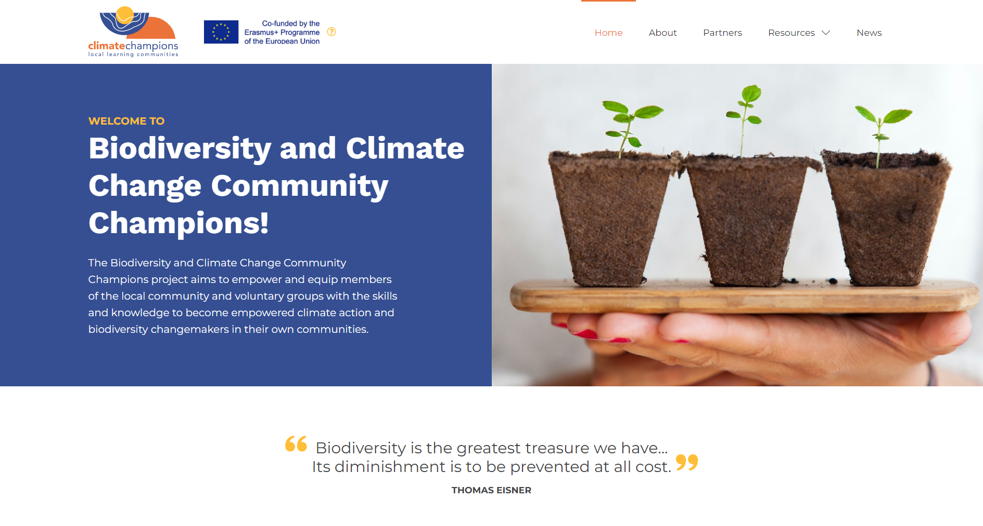

FOLLOW OUR JOURNEY
THANK YOU
FOLLOW OUR JOURNEY
www.climatechampions.eu

